Slide 1
DPC in a nut shell
Dynamic Project Control

Slide 2
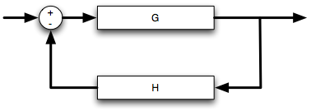
Execute
Plan
Correct
Measure
Compare
Feed back

Slide 3
Monitoring the growth of a flower

Slide 4
Progress and progress speed
Ho much: the dots
How fast: the slope of the red lines

Slide 7
First level: only one root
First and second level
First, second and third level

Slide 8




Every bar below is a task in the Gantt chart
The nr is the line number
Meaning | Syntax | Parallel
2 starts when 1 is completed | 2:1FS | No
12 and 13 start at same time | 13: 12SS | Full
23 and 31 finish at same time | 31: 23FF | Full
45 starts while 44 is still busy; lag is -10 days | 45: 44FS-10d | Partial
1
2
12
13
23
31
44
45

Slide 9
Daisy Tree
S-curve
Daisy tree: total view, tree structure in the rings
Global view
Helps spot where the problems are well ahead of time
S-curve
Blue line: scheduled progress line
Black line: observed progress, dots are measuring points
Green: safe
Yellow: less safe
Orange: lesser safe, consider action
Outside orange (red): problem, need to act

Slide 10
Parallel track
Continue
Divergent track
Need to act
Increase resources
Increase working hours
Improve logistics
Improve communication
Improve information
Convergent track
Your are recovering now
Continue

Slide 11
Track A
Track B
TRACK A
Excellent
Low risk
Stays well in the safe (green zone)
Success
in time
full scope
100% quality
TRACK B
Bad
High risk
Is red zone
Failure
in time, yes, but
not full scope
low quality

Slide 12


The dream track
%
100%
Finish slow
in time
full scope
100% quality
Reasonable speed
Start slow
0%
t

